Slide 1
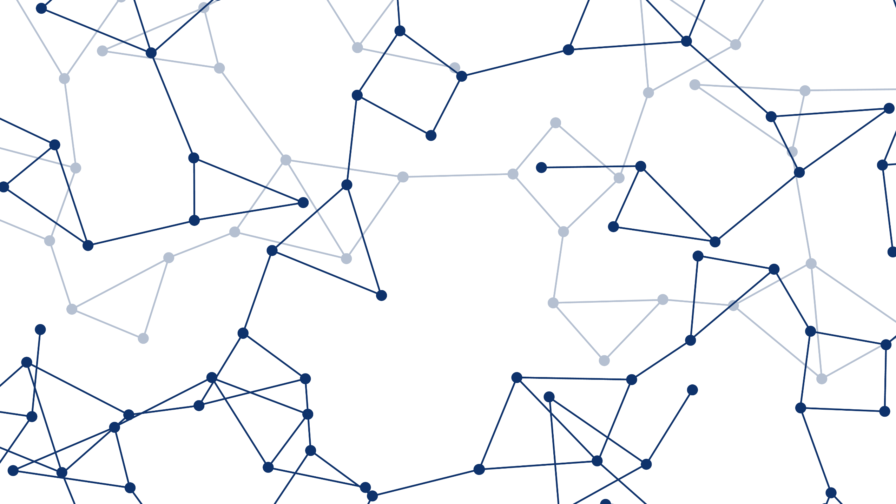
ATOMS-02: UAS Traffic Management I
Using Genetic Algorithm to
Modify Scheduled Flights
to Track Regular Traffic
Leonardo Piñero
17 June 2019

Slide 2
➤ BACKGROUND ➤ METHODOLOGY ➤ RESULTS
Problem Statement
Develop a methodology to alter existing flight routes
NORTH
TARGET OBJECT PATH
UAV SCHEDULED PATH
(UNALTERED)
WEST
EAST
SOUTH

Slide 3
➤ BACKGROUND ➤ METHODOLOGY ➤ RESULTS
Problem Statement
Develop a methodology to alter existing flight routes that balances the conflicting objectives of preserving the original route and increasing coverage of detected target motion
NORTH
TARGET OBJECT PATH
UAV SCHEDULED PATH
(ALTERED)
WEST
EAST
SOUTH

Slide 4
➤ BACKGROUND ➤ METHODOLOGY ➤ RESULTS
Motivation
Existing Solutions to pure SAT take a Probabilistic Approach
The methodology presented intends to contribute a novel heuristic solution based on regular geometry for predictable, but unknown, targets

Slide 5
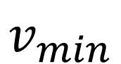
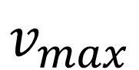
➤ BACKGROUND ➤ METHODOLOGY ➤ RESULTS
Motivation
Existing Solutions to pure SAT take a Probabilistic Approach
The methodology presented intends to contribute a novel heuristic solution based on regular geometry for predictable, but unknown, targets
$$v_{max}$$
$$v_{min}$$
TARGET’S POSSIBLE VELOCITIES FOR CURRENT TIME FRAME
POSSIBLE LOCATIONS AT NEXT TIME FRAME
PROBABILITY MAP INFORMS TRACKING

Slide 6
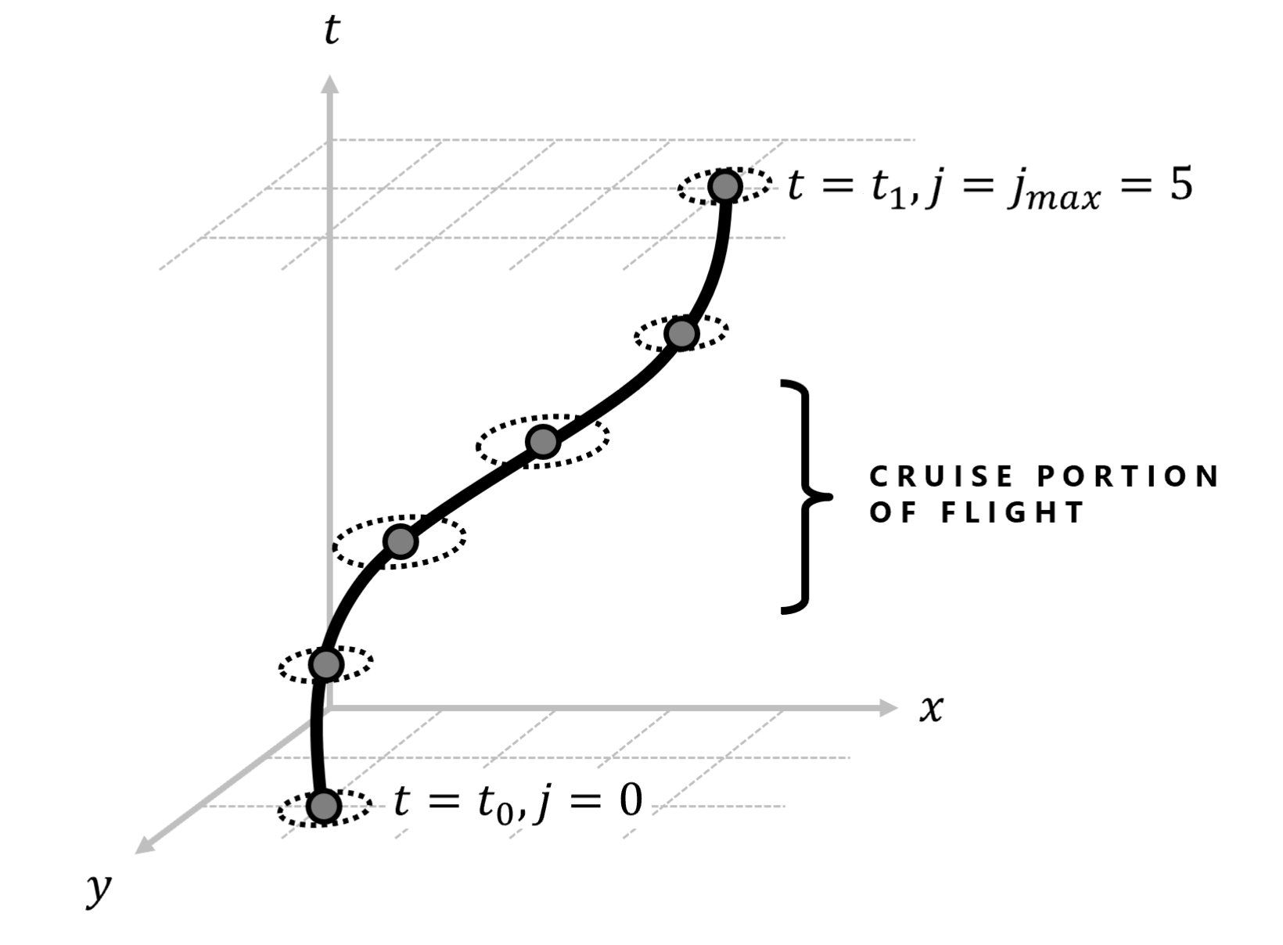
➤ BACKGROUND ➤ METHODOLOGY ➤ RESULTS
Motivation
Existing Solutions to pure SAT take a Probabilistic Approach
The methodology presented intends to contribute a novel heuristic solution based on regular geometry for predictable, but unknown, targets
Geometric Approach to Search-and-Track Problem
The genetic algorithm is guided by imagining regular target paths as 3-dimensional line segments to mold into

Slide 7
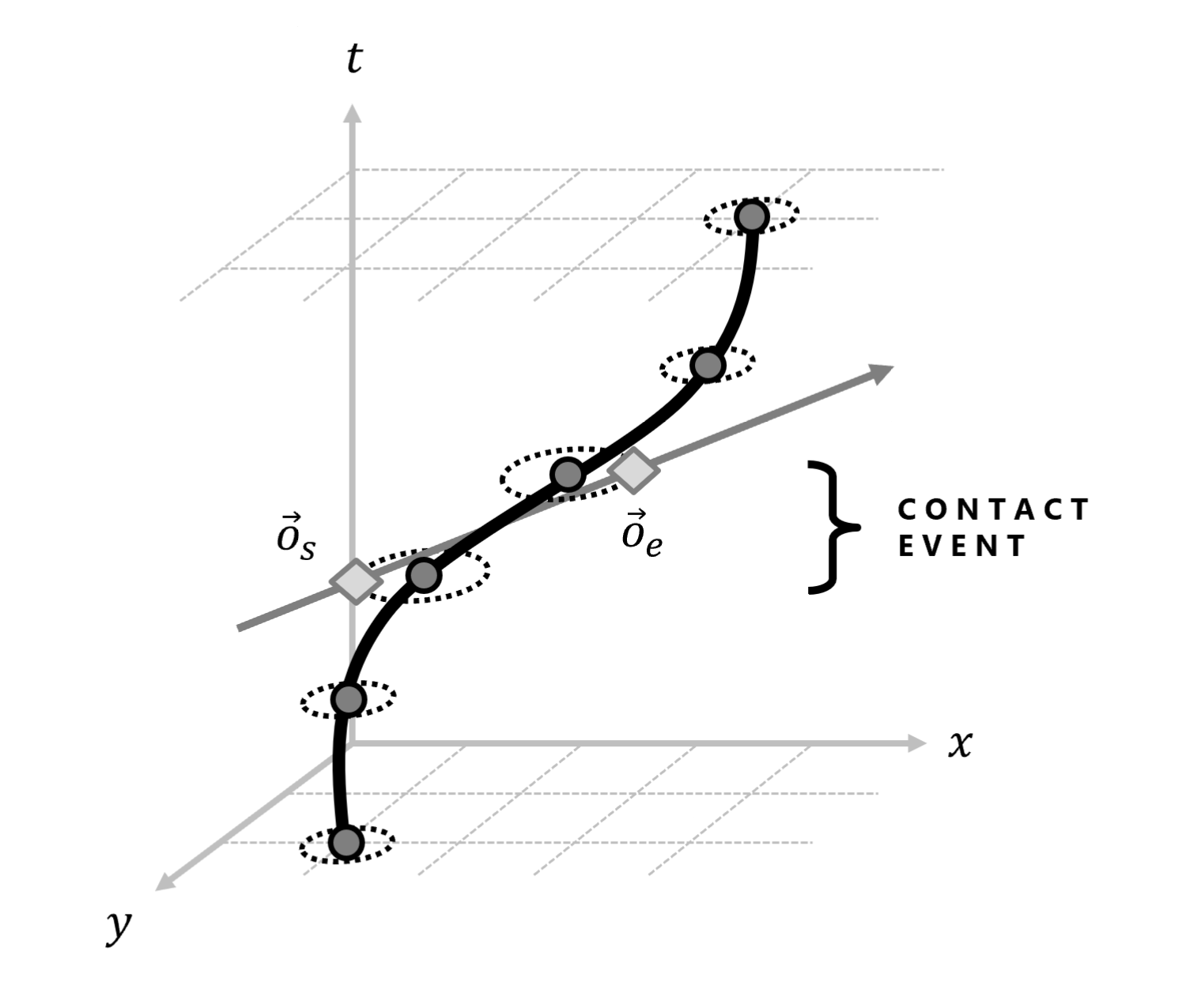
➤ BACKGROUND ➤ METHODOLOGY ➤ RESULTS
Motivation
Existing Solutions to pure SAT take a Probabilistic Approach
The methodology presented intends to contribute a novel heuristic solution based on regular geometry for predictable, but unknown, targets
Geometric Approach to Search-and-Track Problem
The genetic algorithm is guided by imagining regular target paths as 3-dimensional line segments to mold into

Slide 8
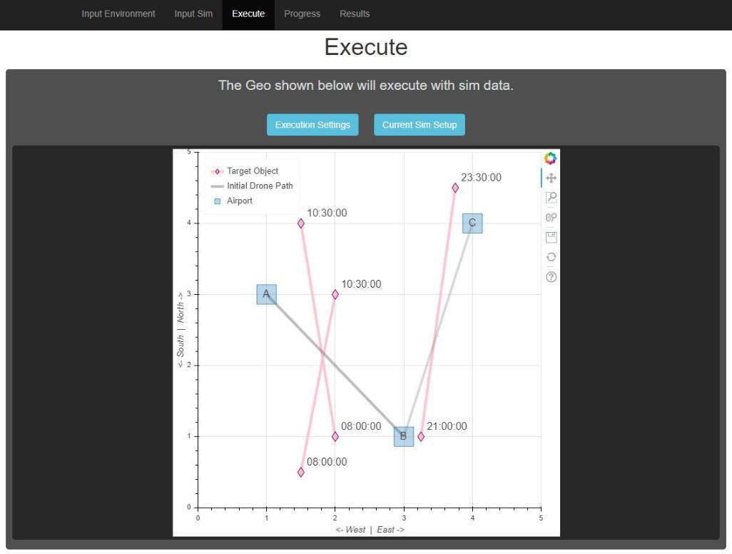
➤ BACKGROUND ➤ METHODOLOGY ➤ RESULTS
Motivation
Existing Solutions to pure SAT take a Probabilistic Approach
The methodology presented intends to contribute a novel heuristic solution based on regular geometry for predictable, but unknown, targets
Geometric Approach to Search-and-Track Problem
The genetic algorithm is guided by imagining regular target paths as 3-dimensional line segments to mold into
Create Open-Source Guidance Software for Managing UAV Fleets
The user interface developed allows the user to utilize the genetic algorithm to increase tracking performance for a fleet

Slide 9
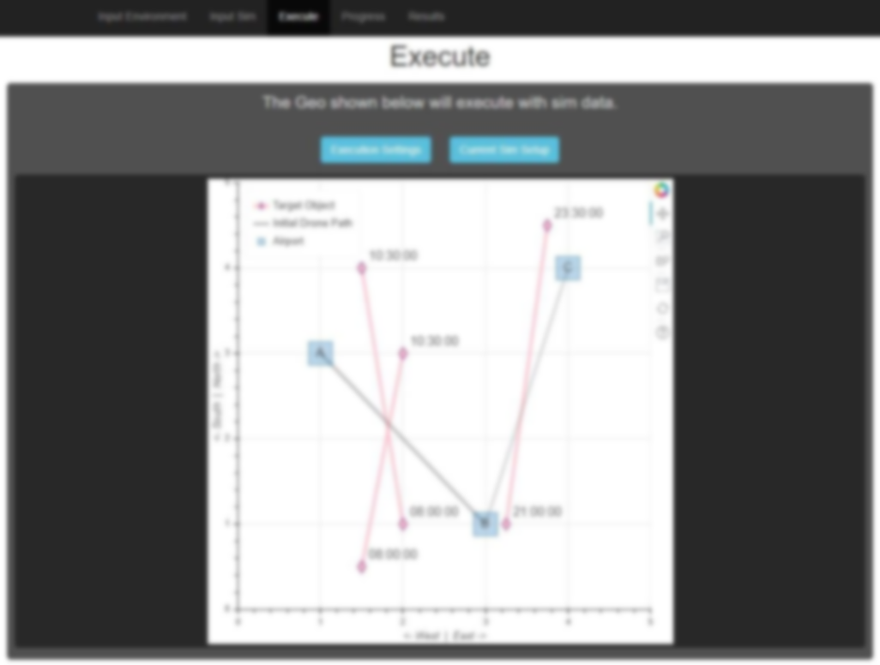
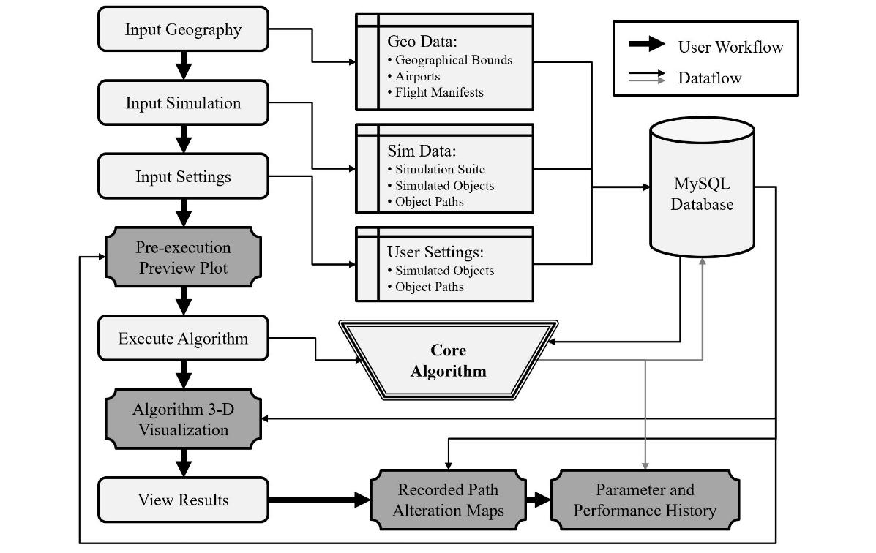
➤ BACKGROUND ➤ METHODOLOGY ➤ RESULTS
Motivation
Existing Solutions to pure SAT take a Probabilistic Approach
The methodology presented intends to contribute a novel heuristic solution based on regular geometry for predictable, but unknown, targets
Geometric Approach to Search-and-Track Problem
The genetic algorithm is guided by imagining regular target paths as 3-dimensional line segments to mold into
Create Open-Source Guidance Software for Managing UAV Fleets
The user interface developed allows the user to utilize the genetic algorithm to increase tracking performance for a fleet

Slide 10

➤ BACKGROUND ➤ METHODOLOGY ➤ RESULTS
Applications
Google Maps Traffic Validation
Existing traffic is estimated by Android users’ anonymized location
UAV routes which give visual confirmation would help determine the reliability of current estimates, especially in areas with low Android usage

Slide 11


➤ BACKGROUND ➤ METHODOLOGY ➤ RESULTS
Applications
Google Maps Traffic Validation
Existing traffic is estimated by Android users’ anonymized location
UAV routes which give visual confirmation would help determine the reliability of current estimates, especially in areas with low Android usage
Ecological Observation
The spatial and temporal resolution of satellite imagery is unreliable for observing smaller fauna, such as water fowl
UAV routes can track the regular movements of fauna throughout the day

Slide 12





➤ BACKGROUND ➤ METHODOLOGY ➤ RESULTS
Applications
Google Maps Traffic Validation
Existing traffic is estimated by Android users’ anonymized location
UAV routes which give visual confirmation would help determine the reliability of current estimates, especially in areas with low Android usage
Ecological Observation
The spatial and temporal resolution of satellite imagery is unreliable for observing smaller fauna, such as water fowl
UAV routes can track the regular movements of fauna throughout the day
Atmospheric Survey
Patterns in air pollution movement may be observed
Satellite imagery has been used, but UAV fleets can provide higher temporal resolution for faster-moving clouds

Slide 13
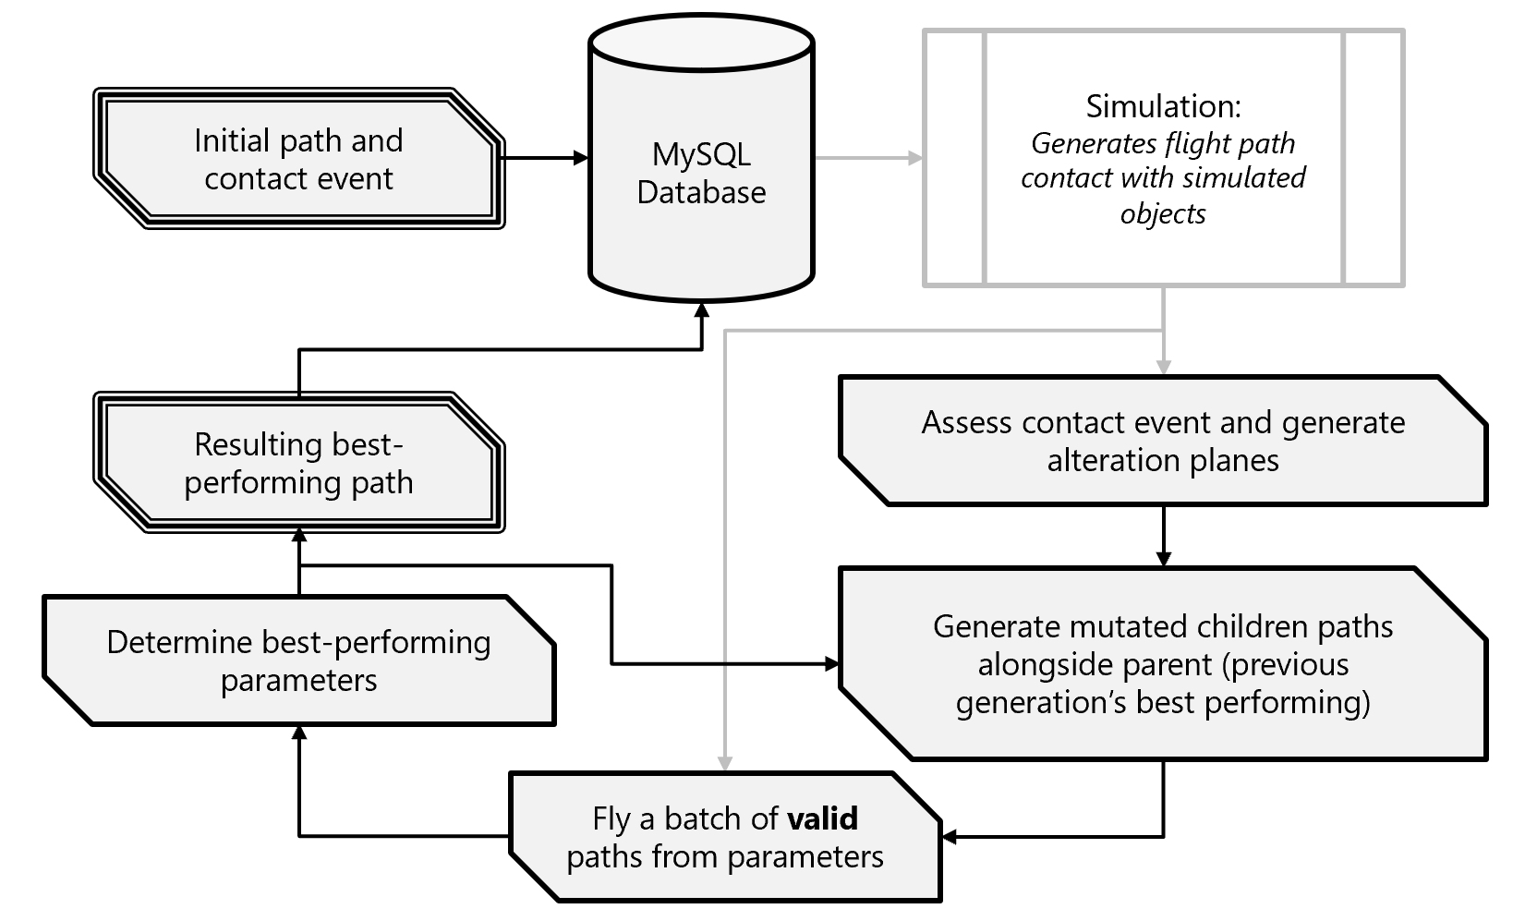
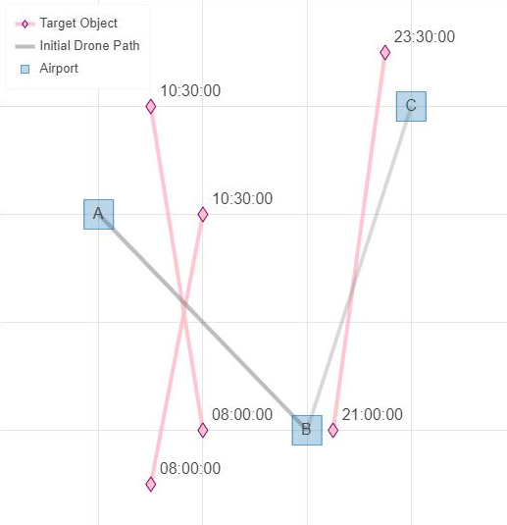
➤ BACKGROUND ➤ METHODOLOGY ➤ RESULTS
Methodology
Main loop of algorithm takes feedback from simulation
NORTH
W
E
S

Slide 14
➤ BACKGROUND ➤ METHODOLOGY ➤ RESULTS
Methodology
Every instance of target contact initializes algorithm

Slide 15
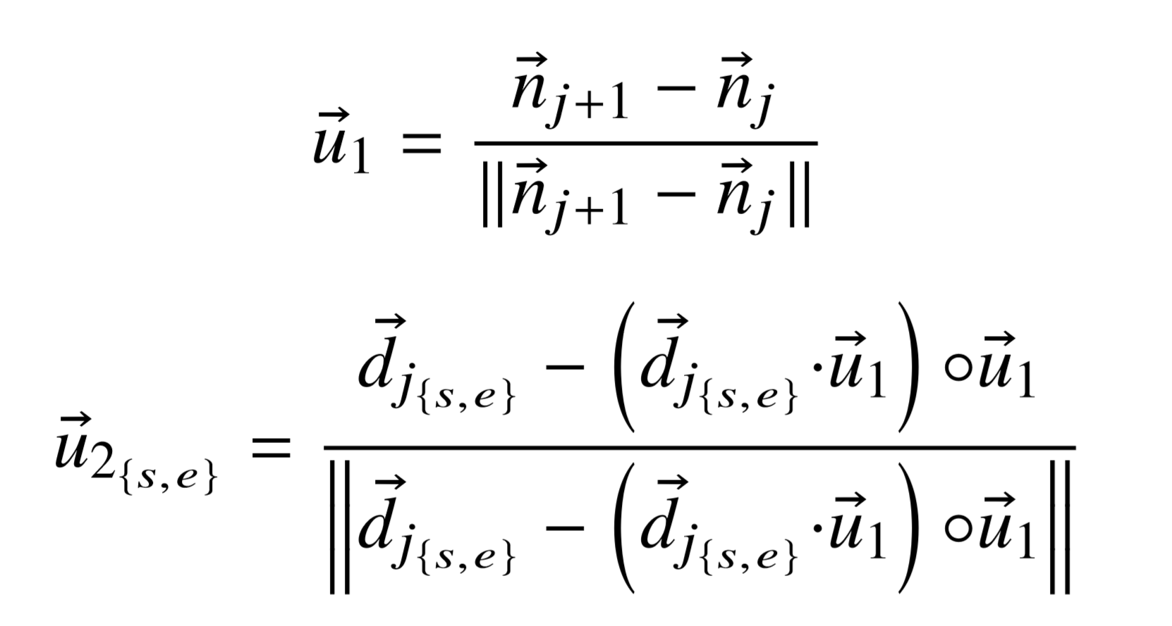
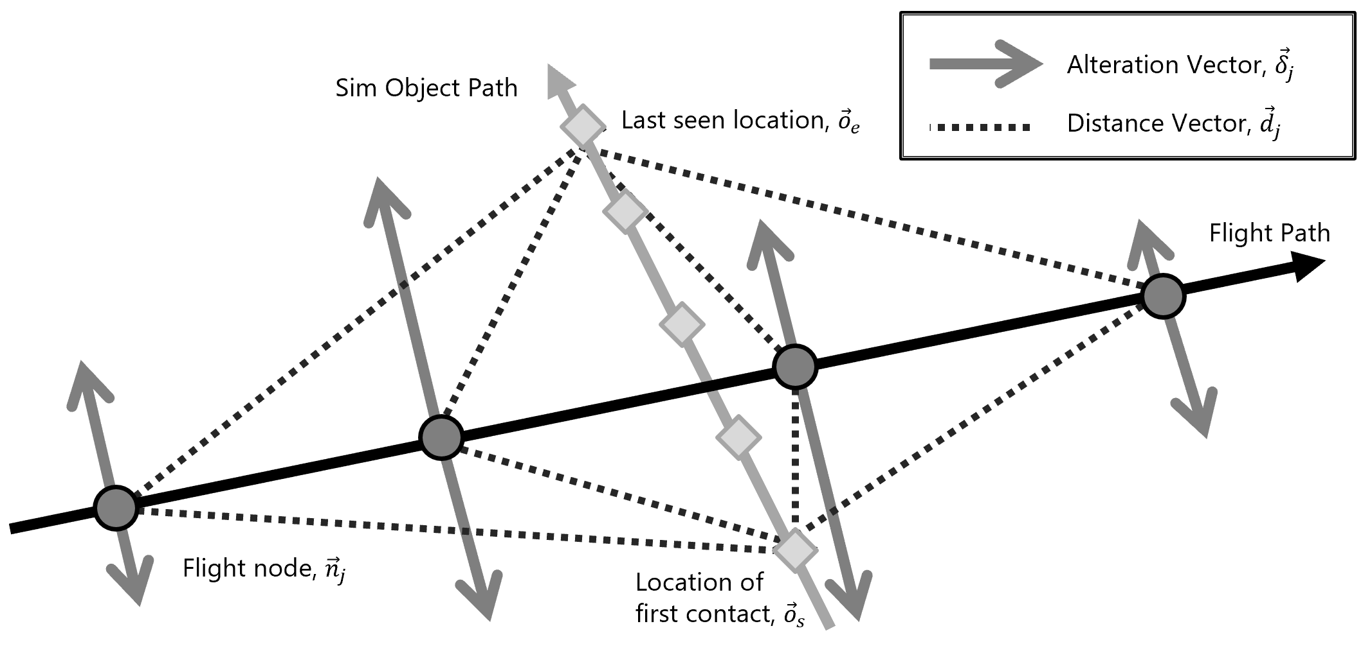
➤ BACKGROUND ➤ METHODOLOGY ➤ RESULTS
Methodology
Generate alteration vectors along common plane in the 3-D path space
BASIS VECTORS OF COMMON PLANE

Slide 16
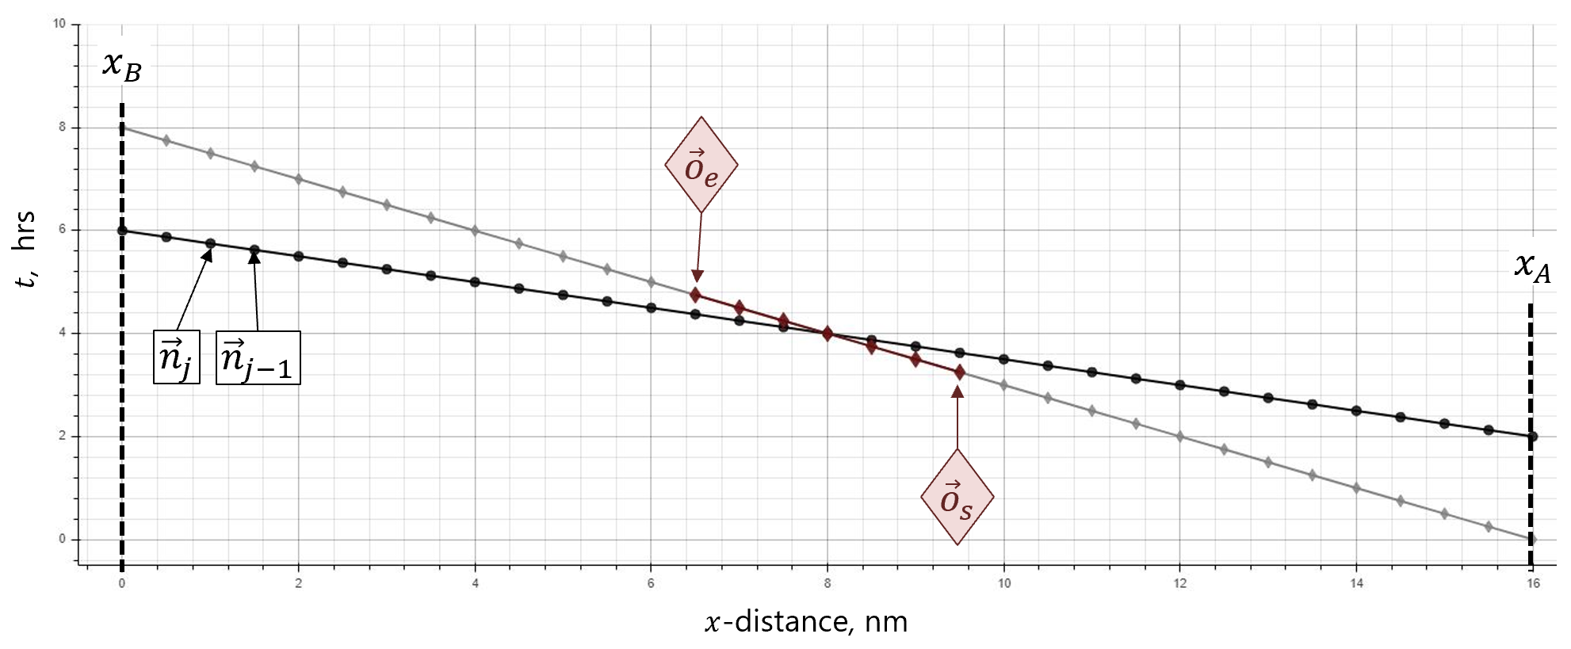
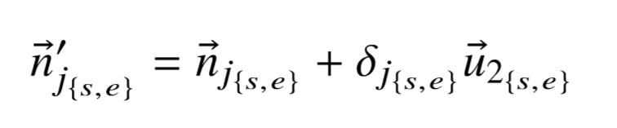
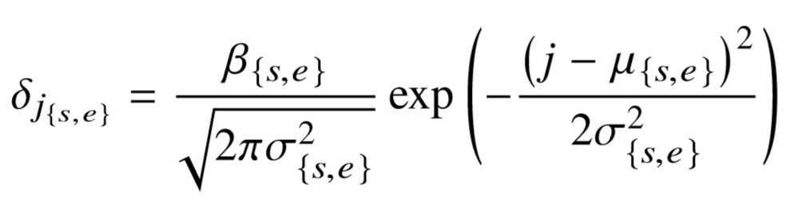
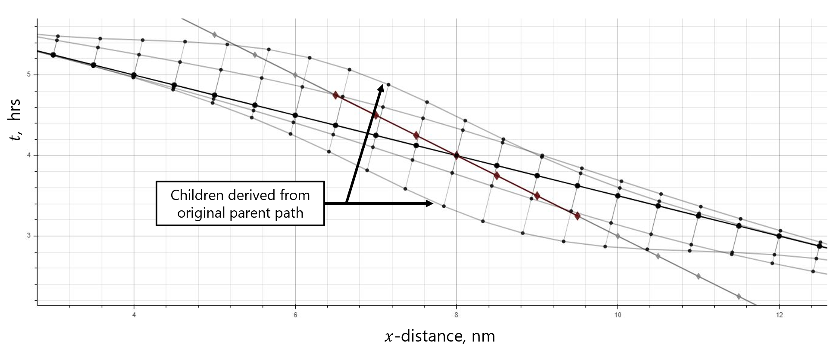
➤ BACKGROUND ➤ METHODOLOGY ➤ RESULTS
Methodology
Children are generated by evolved parameters: ${\left({\left\{β, σ, μ\right\}}_{{\left\{s, e\right\}}_{i}}\right)}_{b}$

Slide 17
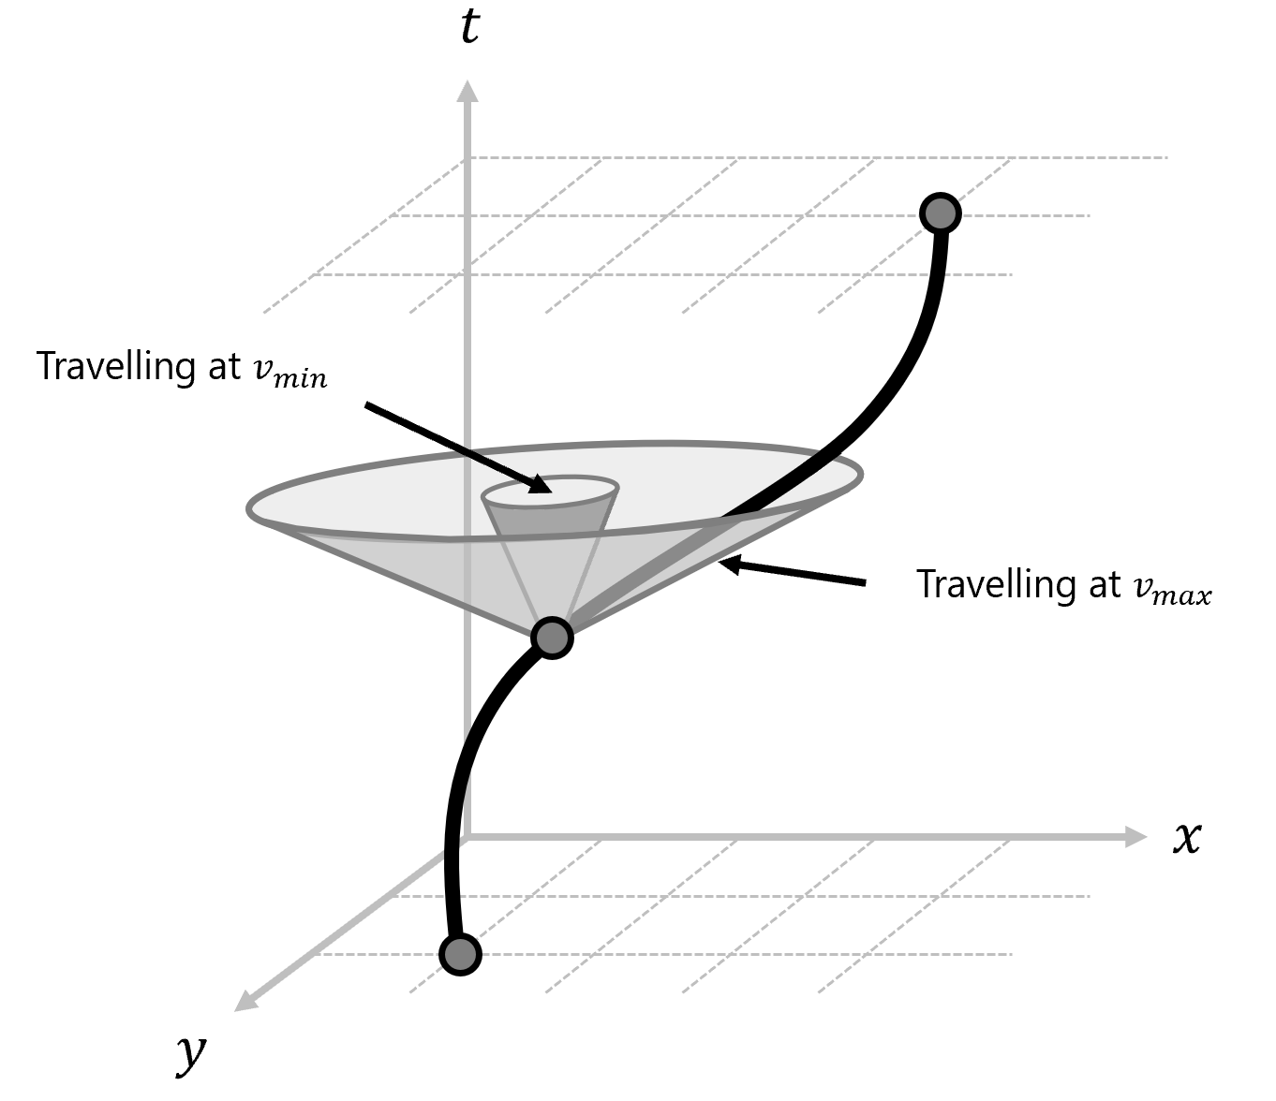
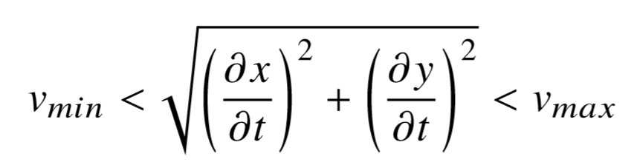
➤ BACKGROUND ➤ METHODOLOGY ➤ RESULTS
Methodology
Some children are impossible to fly, so they are filtered from the batch (hyperparameters will adjust aggressiveness to ensure valid children are created)

Slide 18
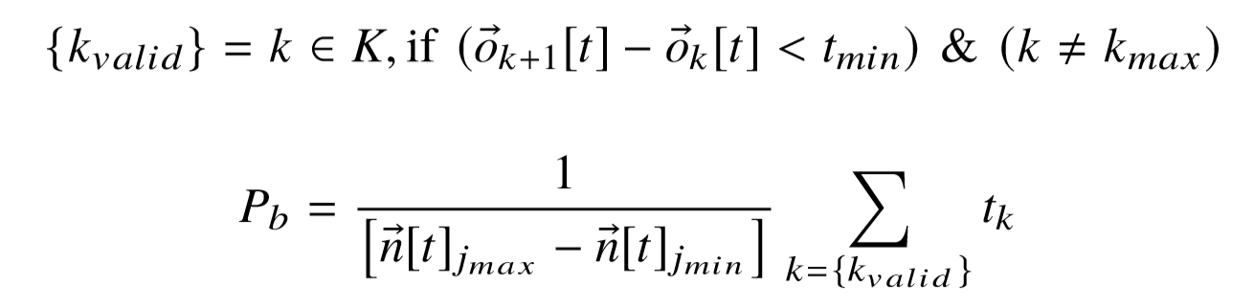
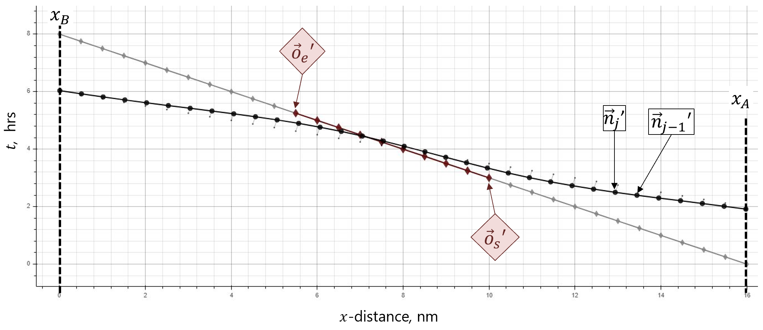
➤ BACKGROUND ➤ METHODOLOGY ➤ RESULTS
Methodology
Parameters ${\left({\left\{β, σ, μ\right\}}_{{\left\{s, e\right\}}_{i}}\right)}_{b_{P_{max}}}$which led to the best-performing child are kept for next generation
Performance is determined by the percentage of the ﬂight time where the drone is in contact with target object

Slide 19
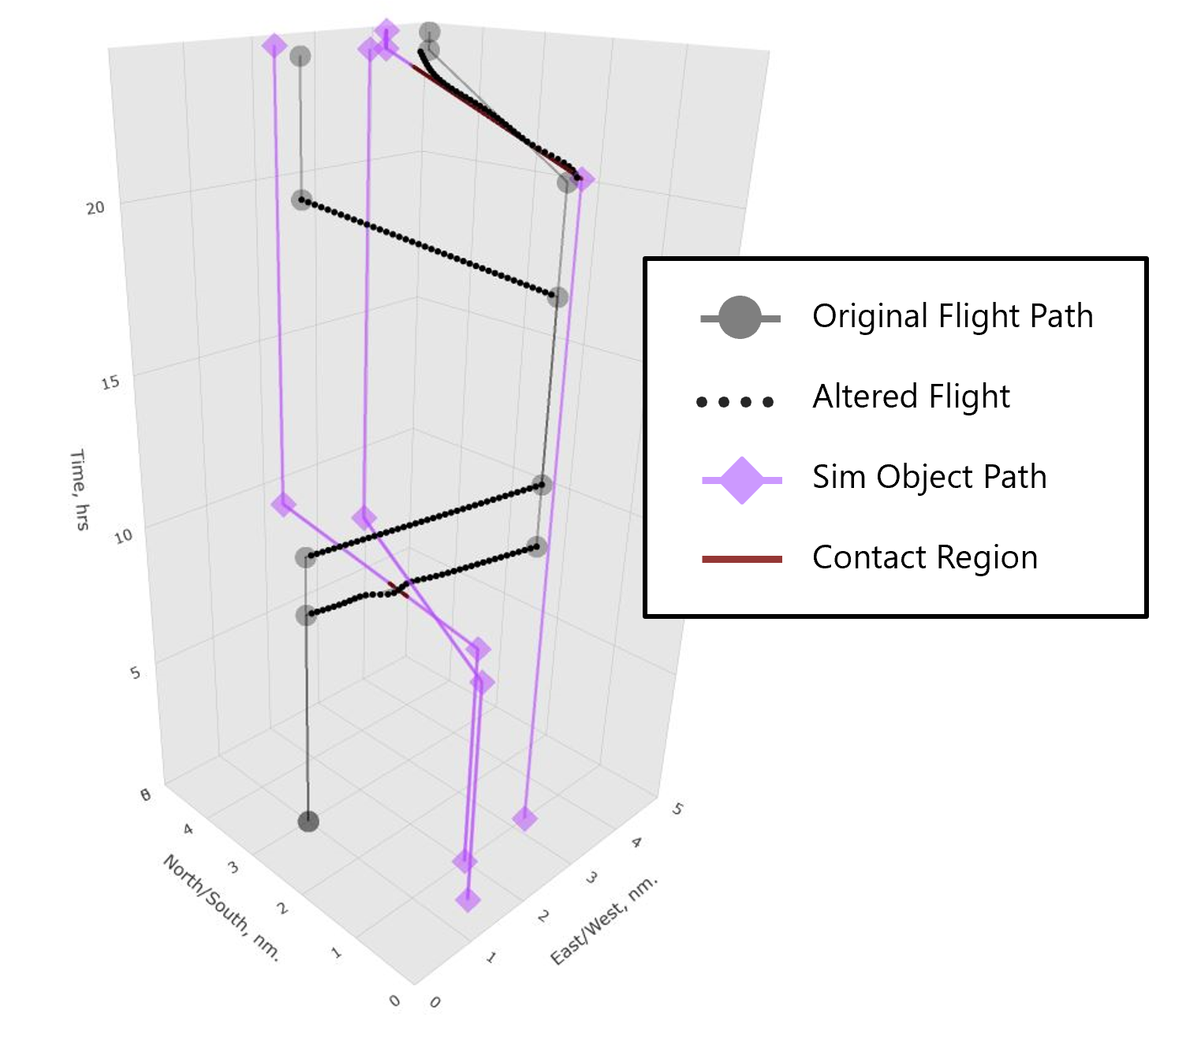
➤ BACKGROUND ➤ METHODOLOGY ➤ RESULTS
Results
Initial conditions to end result of simulation:
NORTH
W
E
S

Slide 20
➤ BACKGROUND ➤ METHODOLOGY ➤ RESULTS
Results
Initial conditions to end result of simulation:
NORTH
W
E
S

Slide 21
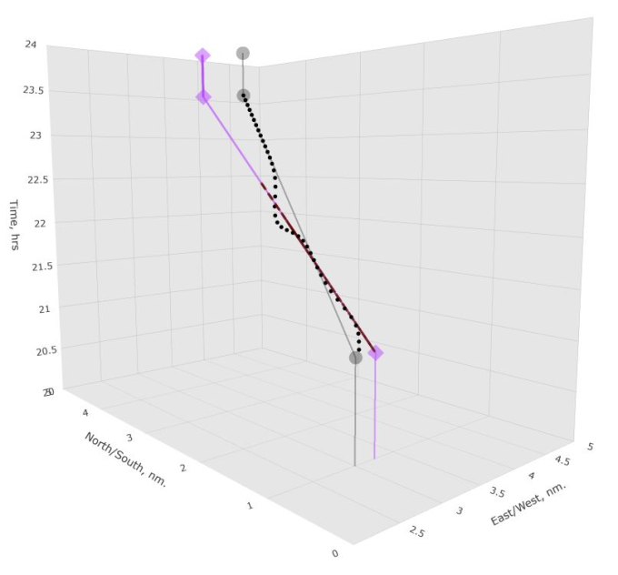
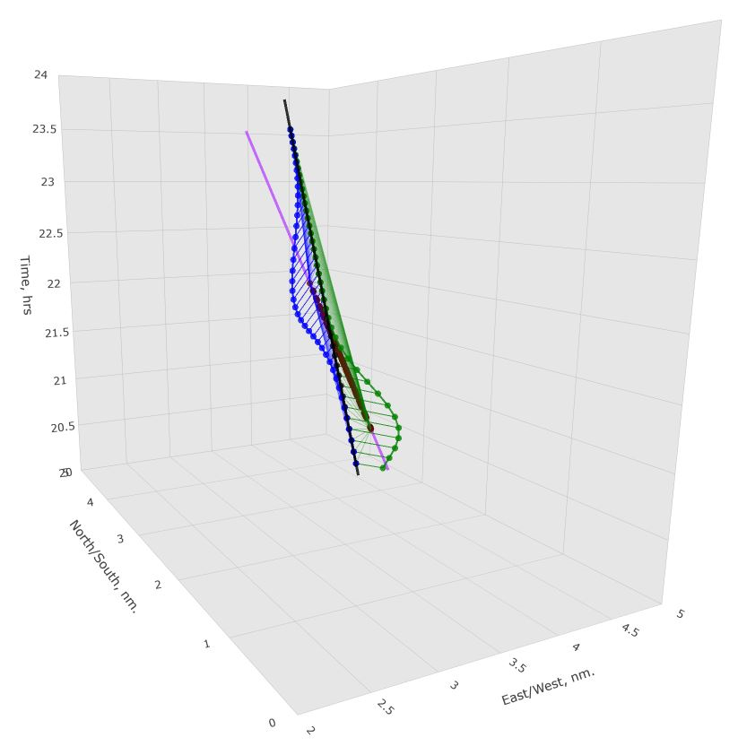
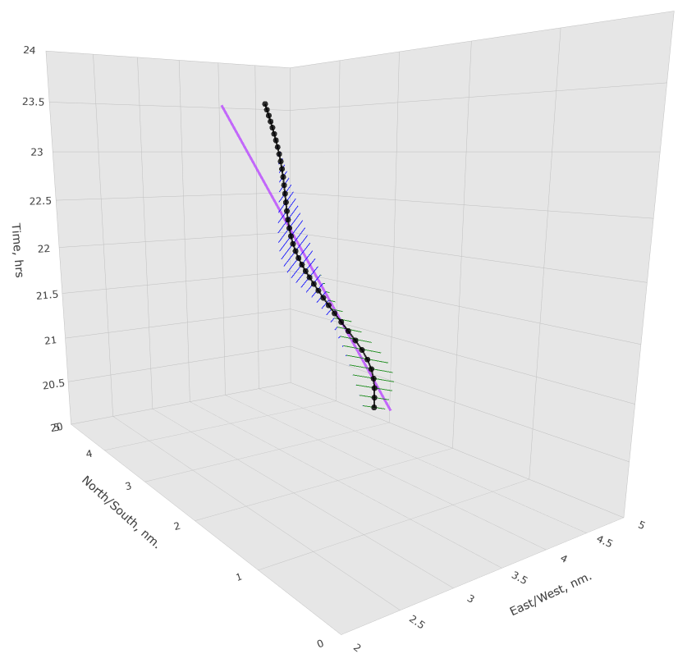
➤ BACKGROUND ➤ METHODOLOGY ➤ RESULTS
Results
Evolution of the examined path:
INITIAL HEURISTIC GUESS
APPLIED SHAPING PARAMETERS
SHAPED NODES ARE BLENDED TO FORM ALTERED PATH

Slide 22
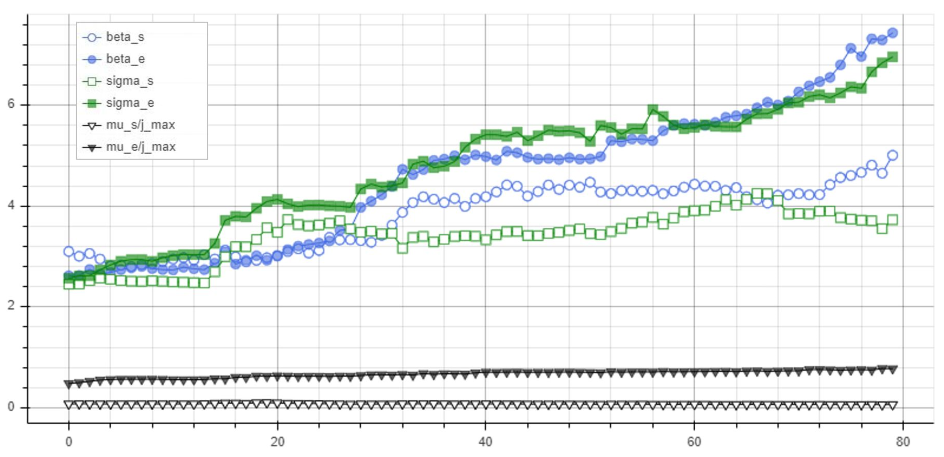
➤ BACKGROUND ➤ METHODOLOGY ➤ RESULTS
Results
Evolution of the examined path (Parameters):
Value
Generation

Slide 23
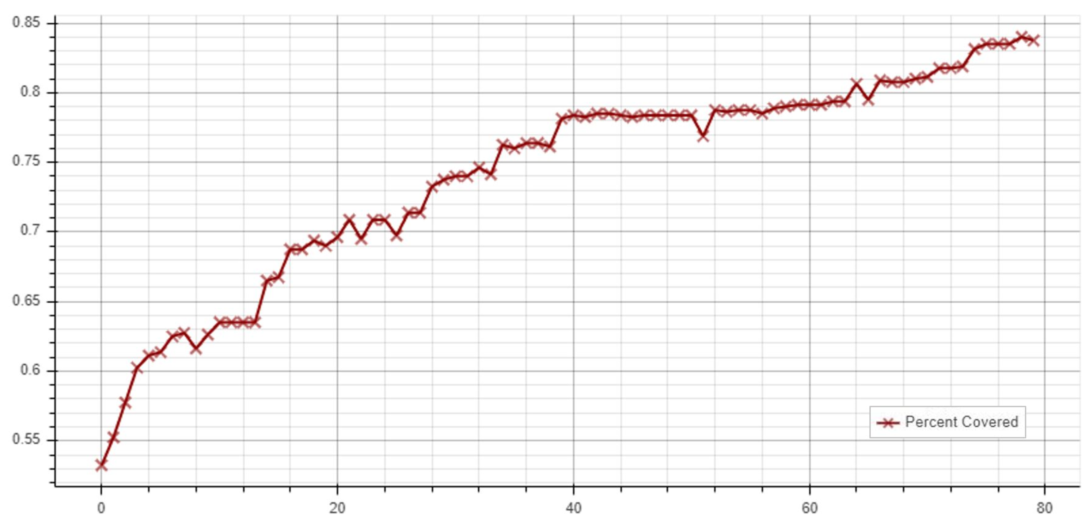
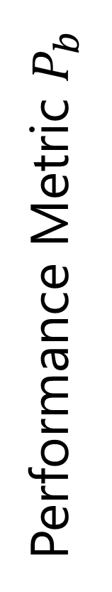
➤ BACKGROUND ➤ METHODOLOGY ➤ RESULTS
Results
Evolution of the examined path (Parameters):
Performance Metric $P_{b}$
Generation

Slide 24
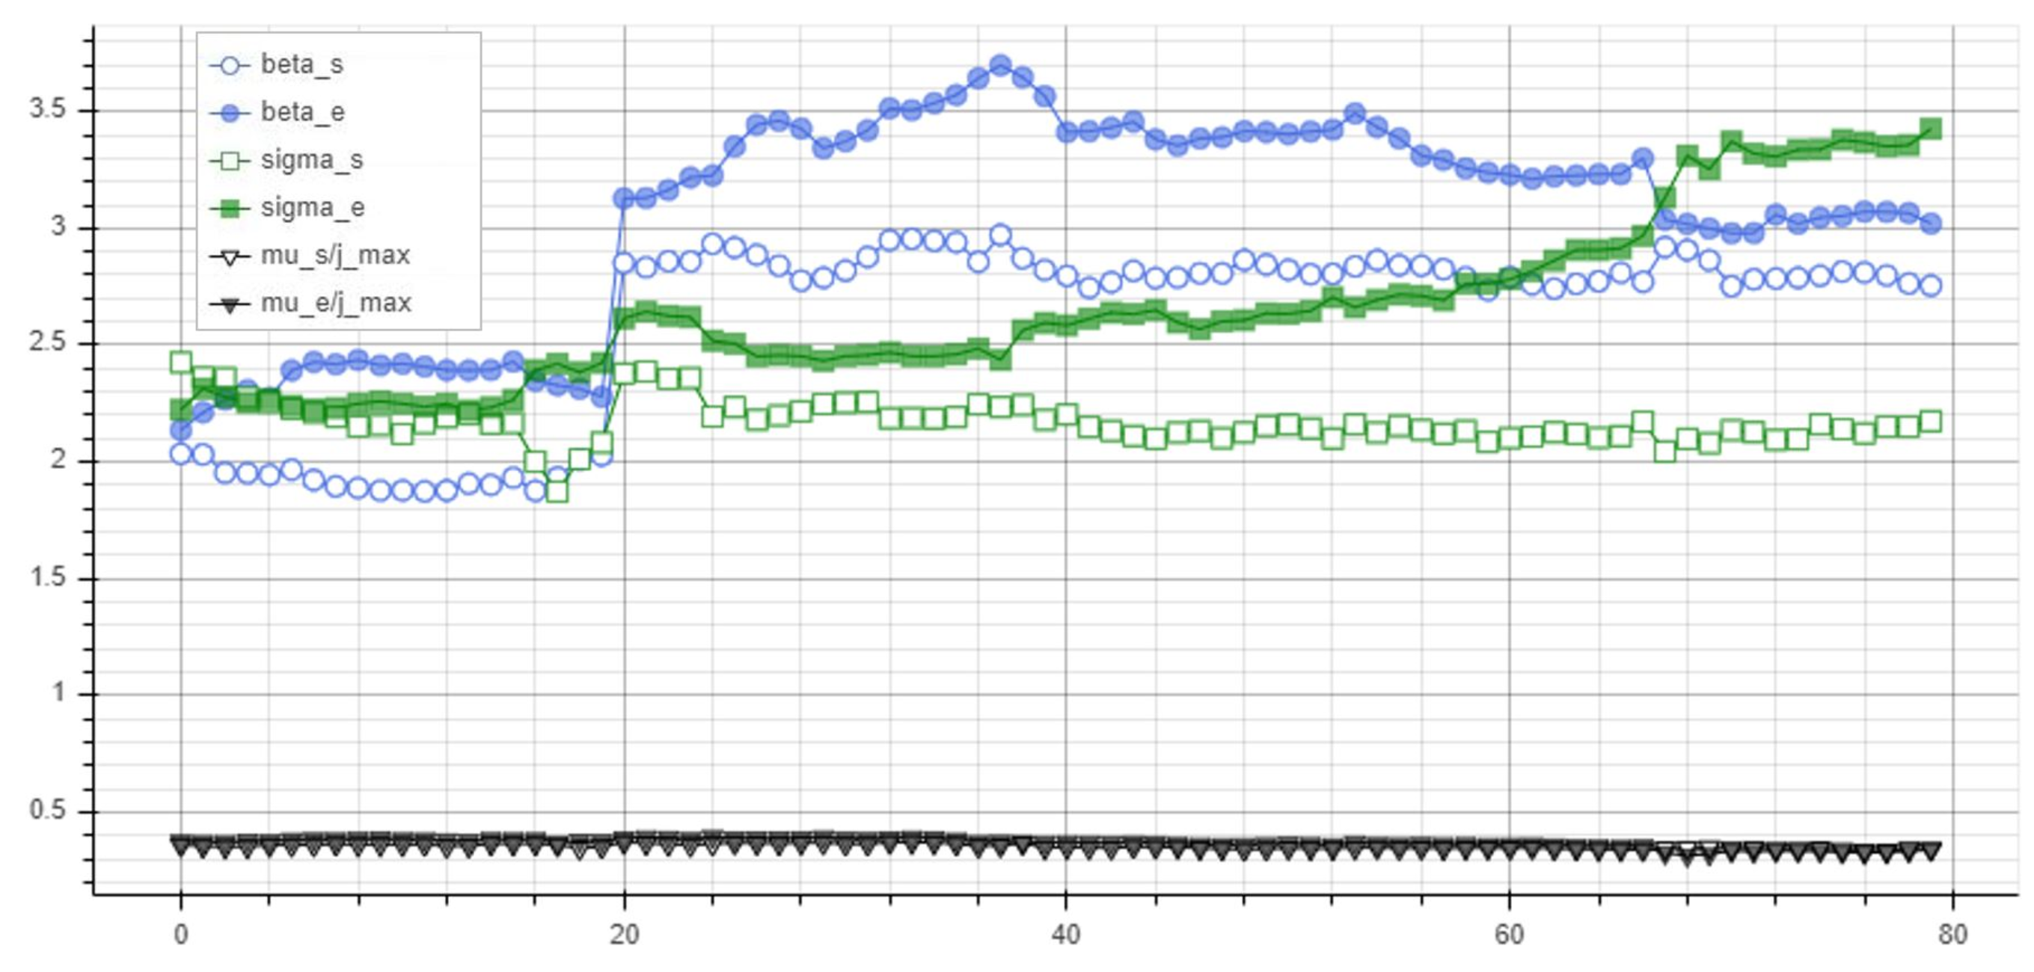
➤ BACKGROUND ➤ METHODOLOGY ➤ RESULTS
Results
Evolution of the examined path (Parameters):
Value
Generation

Slide 25
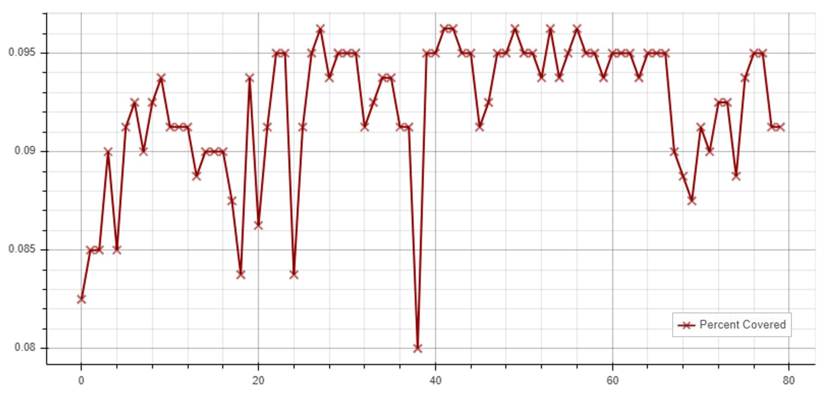
➤ BACKGROUND ➤ METHODOLOGY ➤ RESULTS
Results
Evolution of the examined path (Parameters):
Performance Metric $P_{b}$
Generation

Slide 28
➤ BACKGROUND ➤ METHODOLOGY ➤ RESULTS
Problem Statement
Deviating existing fleet operations to better track patterns in traffic
NORTH
TARGET OBJECT PATH
UAV SCHEDULED PATH
(UNALTERED)
WEST
EAST
SOUTH

Slide 29
➤ BACKGROUND ➤ METHODOLOGY ➤ RESULTS
Problem Statement
Deviating existing fleet operations to better track patterns in traffic
NORTH
TARGET OBJECT PATH
UAV SCHEDULED PATH
(ALTERED)
WEST
EAST
SOUTH

Slide 30
MOTIVATION
Applications
Alternative
Write Something
Refers to a good or service being offered by a company. Ideally, a product should meet a certain consumer demand.
Refers to a good or service being offered by a company. Ideally, a product should meet a certain consumer demand.
Solution
Your Title
Refers to a good or service being offered by a company. Ideally, a product should meet a certain consumer demand.
Refers to a good or service being offered by a company. Ideally, a product should meet a certain consumer demand.

Slide 31
MOTIVATION
Applications
Alternative
Write Something
Refers to a good or service being offered by a company. Ideally, a product should meet a certain consumer demand.
Refers to a good or service being offered by a company. Ideally, a product should meet a certain consumer demand.
Solution
Your Title
Refers to a good or service being offered by a company. Ideally, a product should meet a certain consumer demand.
Refers to a good or service being offered by a company. Ideally, a product should meet a certain consumer demand.

Slide 32
WRITE SOMETHING HERE
SERVICES
Title One
Title Two
Title Three
Title Four
Marketers must link the price to the real and perceived value of the product,
Marketers must link the price to the real and perceived value of the product,
Marketers must link the price to the real and perceived value of the product,
Marketers must link the price to the real and perceived value of the product,

Slide 33
WRITE SOMETHING HERE
STATICS
Title One
Title Two
Title Three
Title Four
Marketers must link the price to the real.
Marketers must link the price to the real.
Marketers must link the price to the real.
Marketers must link the price to the real.

Slide 34


WRITE SOMETHING HERE
PRODUCTS
Title One
Refers to a good or service being offered by a company. Ideally, a product should meet a certain consumer demand.
Title Two
Refers to a good or service being offered by a company. Ideally, a product should meet a certain consumer demand.
Title Three
Refers to a good or service being offered by a company. Ideally, a product should meet a certain consumer demand.

Slide 35
WRITE SOMETHING HERE
ANALYSIS
60%
75%
Project
Project
Marketers must link the price to the real and perceived value of the product.
Marketers must link the price to the real and perceived value of the product.
20%
90%
Project
Project
Marketers must link the price to the real and perceived value of the product.
Marketers must link the price to the real and perceived value of the product.

